Slide 1

Capstone Project
Cardiovascular Risk Prediction

Slide 2

Team Consists of: 1. ameen attar 2. Hrithik Chourasia 3. Pradip Solanki 4. Vridhi Parmar

Slide 3
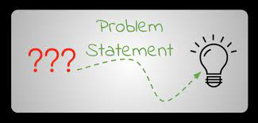
Problem Statement:
The dataset is from an ongoing cardiovascular study on residents of the town of Framingham, Massachusetts.
The classification goal is to predict whether the patient has a 10-year risk of future coronary heart disease(CHD).
The dataset provides the patients’ information. It includes over 4,000 records and 15 attributes. Variable Each attribute is a potential risk factor. There are both demographic, behavioral, and medical risk factors.

Slide 4
Data description:
Demographic:
Sex: male or female("M" or "F")
Age: Age of the patient;(Continuous - Although the recorded ages have been truncated to whole numbers, the concept of age is continuous)
Behavioral
is_smoking: whether or not the patient is a current smoker ("YES" or "NO")
Cigs Per Day: the number of cigarettes that the person smoked on average in one day.(can be considered continuous as one can have any number of cigarettes, even half a cigarette.)
Medical( history)
BP Meds: whether or not the patient was on blood pressure medication (Nominal)
Prevalent Stroke: whether or not the patient had previously had a stroke (Nominal)
Prevalent Hyp: whether or not the patient was hypertensive (Nominal)
Diabetes: whether or not the patient had diabetes (Nominal) Medical(current)
Tot Chol: total cholesterol level (Continuous)
Sys BP: systolic blood pressure (Continuous)
Dia BP: diastolic blood pressure (Continuous)
BMI: Body Mass Index (Continuous)
Heart Rate: heart rate (Continuous - In medical research, variables such as heart rate though in fact discrete, yet are considered continuous because of large number of possible values.)
Glucose: glucose level (Continuous) Predict variable (desired target)
10-year risk of coronary heart disease CHD(binary: “1”, means “Yes”, “0” means “No”) - DV

Slide 5
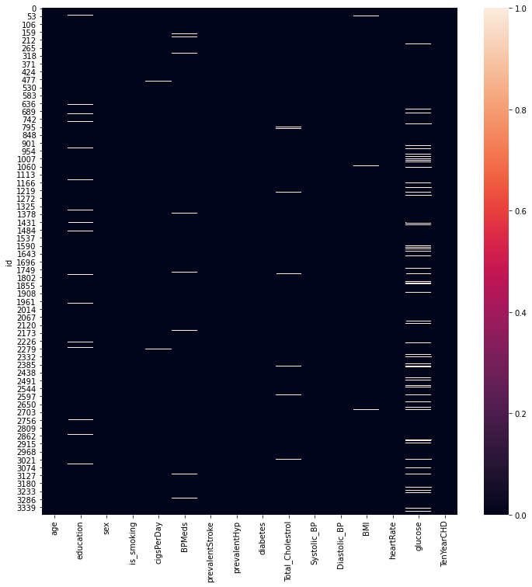
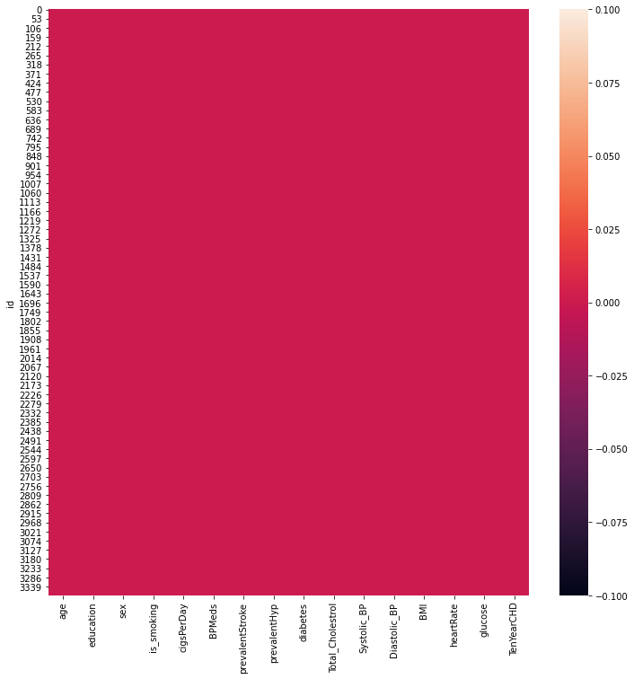
Missing Values & After filling NaN Values

Slide 6
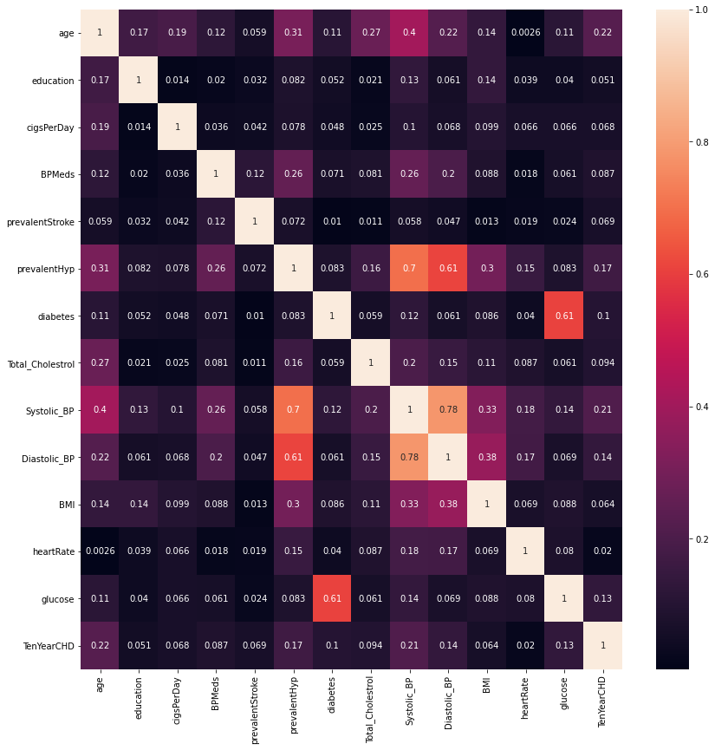
Correlation between each features

Slide 7
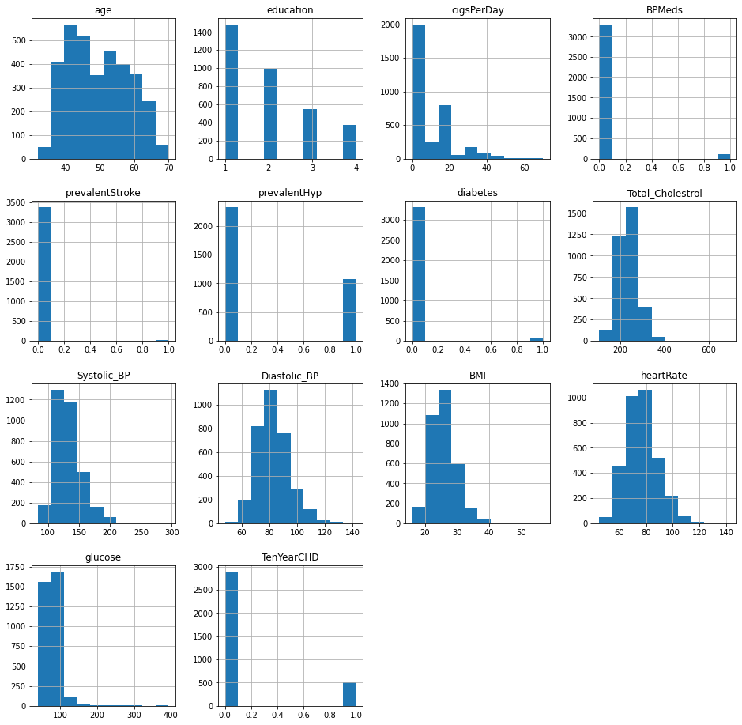
Distribution of data

Slide 8
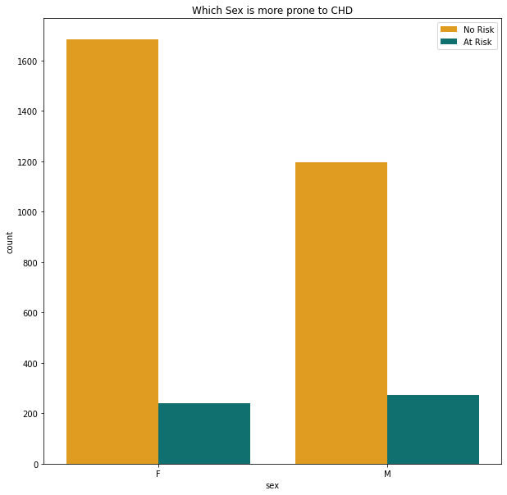
Which Sex is more prone to CHD ?

Slide 9
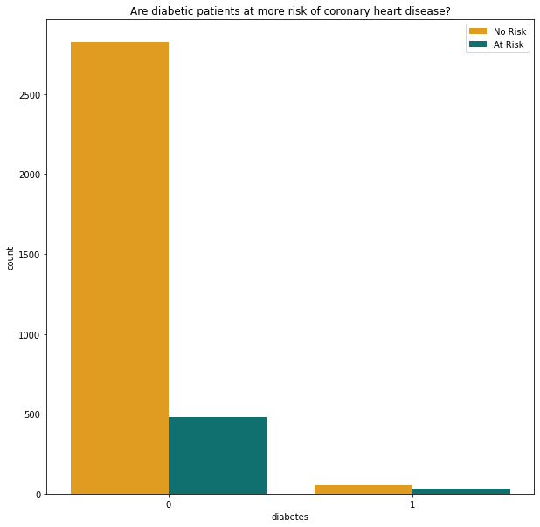
Are diabetic patients at more risk of chd ?

Slide 10
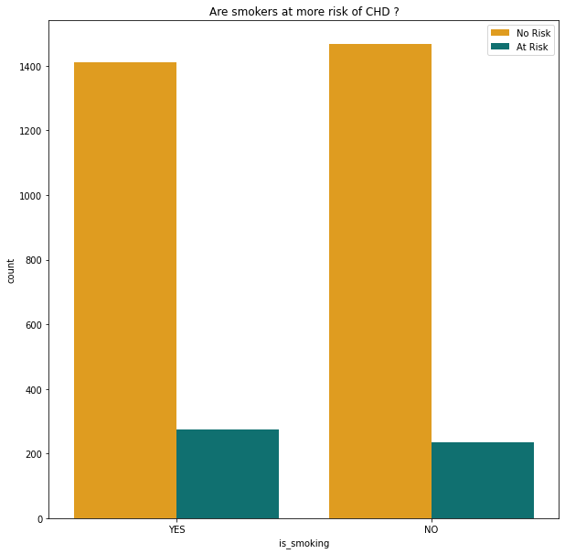
Are smokers at more risk of chd ?

Slide 11
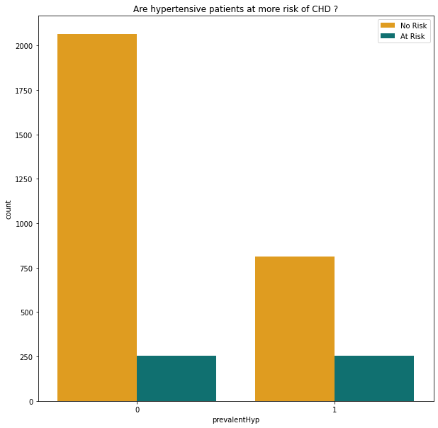
Are hypertensive patients at more risk of chd ?

Slide 12
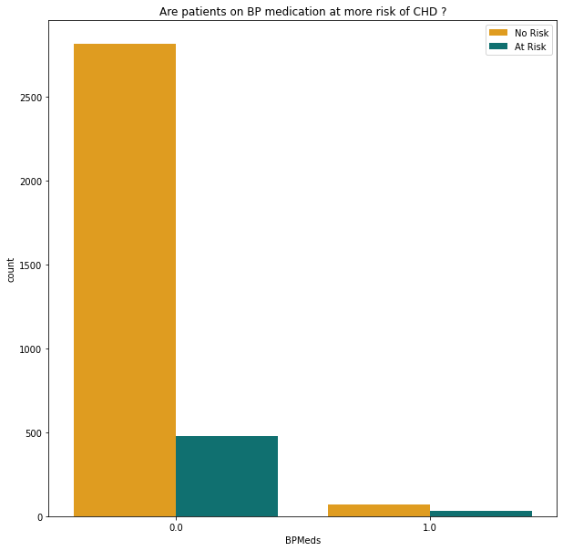
Are patients on bp medication at more risk of chd ?

Slide 13
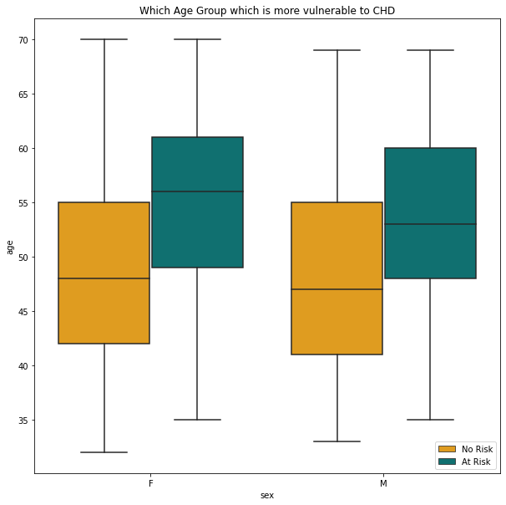
Which age group is more vulnerable to chd ?

Slide 14
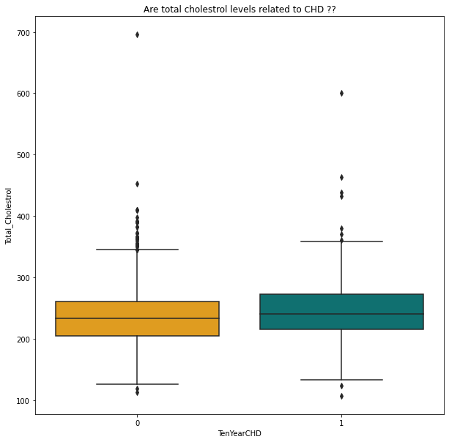
Are total cholesterol levels related to chd ?

Slide 15
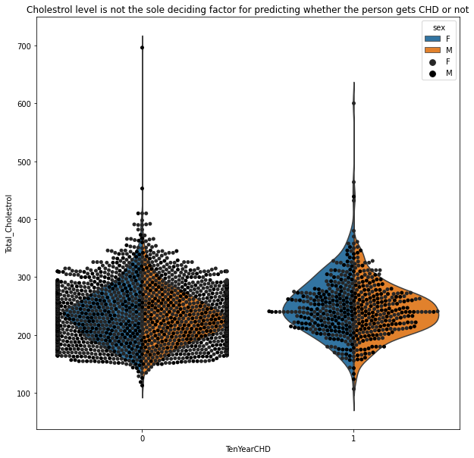
Cholestrol level is not the sole deciding factor for chd

Slide 16
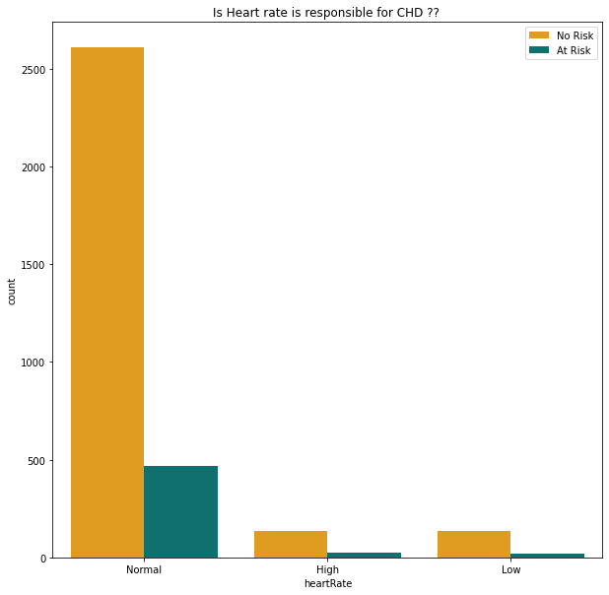
Is heart rate is responsible for chd ?

Slide 17
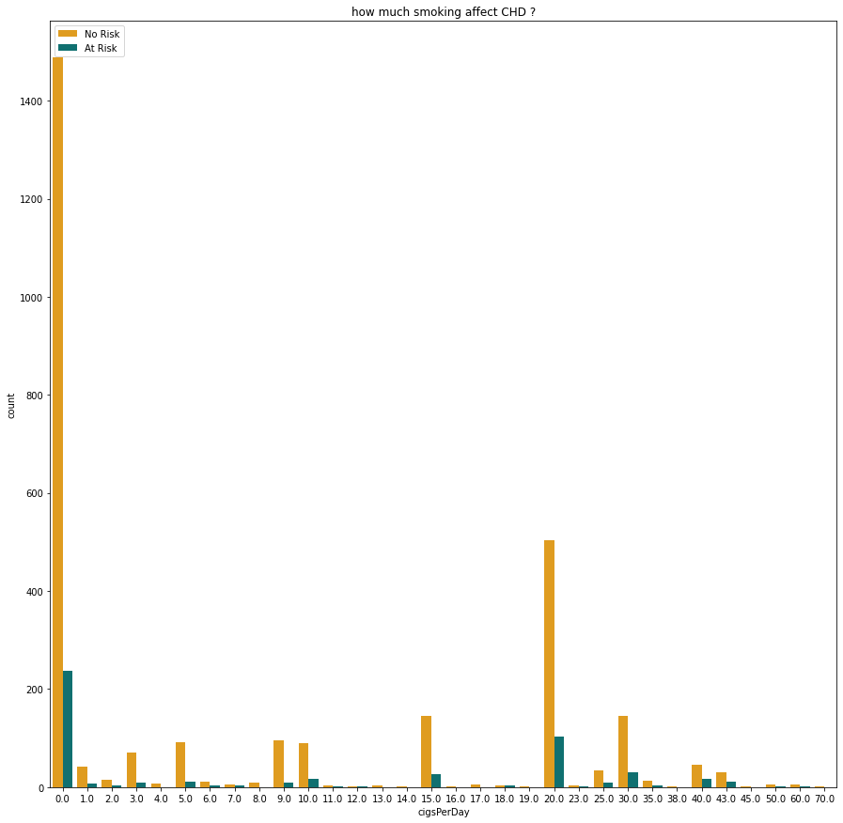
How much Smoking affect chd ?

Slide 18
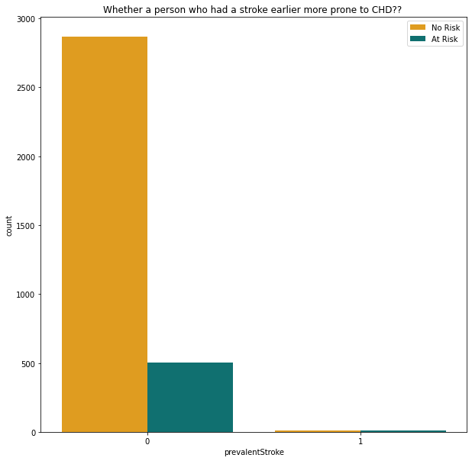
Who had a stroke earlier more prone to chd ?

Slide 19
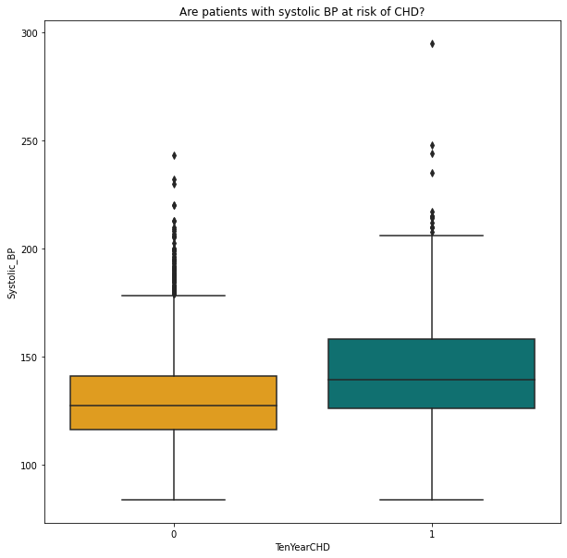
Are patients with systolic bp at risk of chd ?

Slide 20
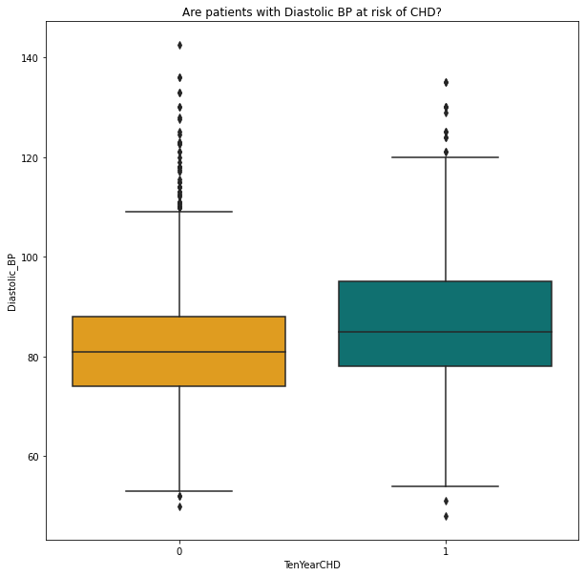
Are patients with diastolic bp at risk of chd ?

Slide 21
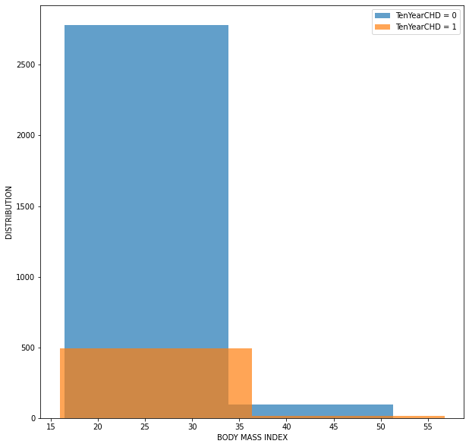
patients bmi is important to show the risk of chd ?

Slide 22
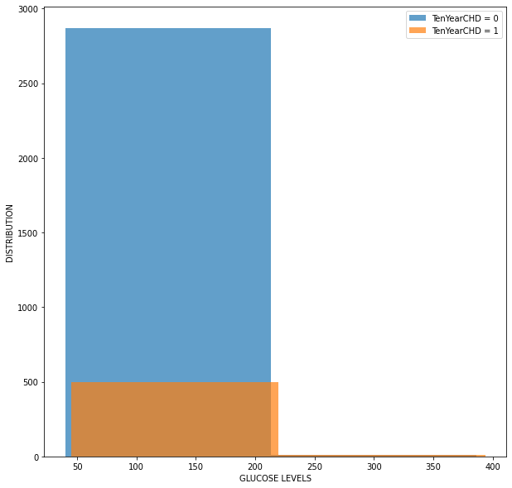
Can patients glucose levels show the risk of chd ?

Slide 23
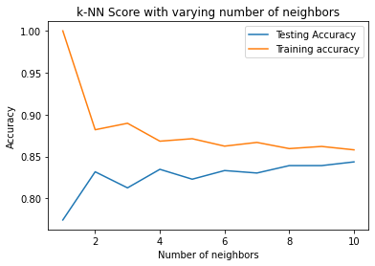
K-nn score with varying number of neighbors

Slide 24
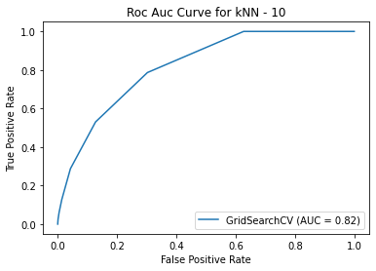
Roc auc curve for knn

Slide 25
The best fitting Model:-
Sr.no | ML Model | Test Accuracy Score | Train Accuracy Score
1 | Naive Bayes Classifier | 81 | 83
2 | KNN | 84 | 86
3 | Logistic Regression | 84 | 86
4 | Decision Tree | 75 | 76
5 | Random Forest | 89 | 99.8
6 | Gradient Boost | 87 | 90
7 | XGBoost | 97 | 83

Slide 26
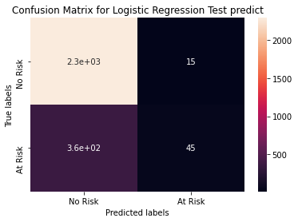
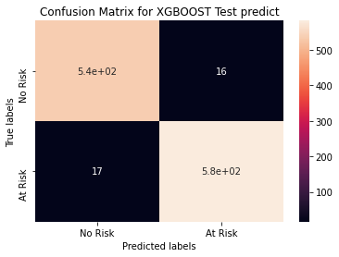
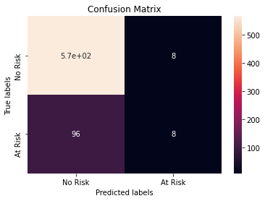
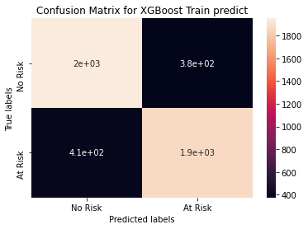
Confusion Matrix

Slide 27
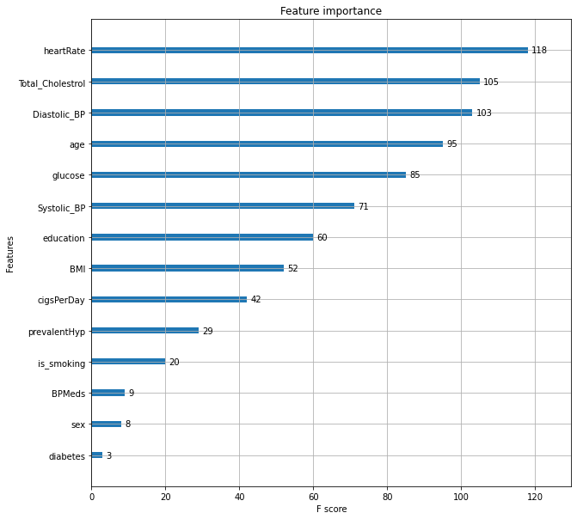
The Feature Importance

Slide 28
challenges:
Less amount of data available made it difficult to predict properly.
Missing useful features.

Slide 29

Conclusion:
That's it! We reached here at the end of our exercise.
Starting with loading the data so far we have done EDA , null values treatment, encoding of categorical columns, feature selection and then model building.
In all of these models our accuracy revolves in the range of 66 to 91%.
And there is no such improvement in accuracy score even after hyperparameter tuning.
So the accuracy of our best model is 91% which can be said to be good for this large dataset.
This performance could be due to various reasons like: no proper pattern of data, too much data, not enough relevant features but maybe with enough data we can train out model even better.

